Slide 1
ClassSync
Project focus
A calendar integration project for WWU students
Combine academic scheduling with students' existing calendar habits
Reduce manual copying, screenshots, and missed dates
Export schedule data as a portable .ics calendar file
Team: Minnie Lee, Mitrasree Deb, Ryan Harang
01

Slide 2
CLASSSYNC
Project Introduction: The Scheduling Gap
Students manage school, assignments, and personal life across disconnected systems.
Design need
Canvas or LMS calendars track assignments, but not always class meeting schedules.
One reliable way to move academic schedule events into a calendar students already use.
Web4U shows course schedules, but students cannot easily export or merge them.
Personal calendars such as Outlook, Google Calendar, and Apple Calendar remain separate.
02

Slide 3
CLASSSYNC
Interview Findings
Need-finding interviews with WWU students showed a strong preference for one combined calendar view.
Export friction
Tool overload
Weak quarter view
LMS reliance
Web4U schedules often become screenshots instead of reusable calendar data.
Students switch among Web4U, Canvas/Moodle, and personal calendars.
Weekly timetable views do not show the full quarter rhythm.
Students value LMS calendars, but want more consistency and customization.
Design implication: make calendar export obvious, guided, and lightweight.
03

Slide 4
CLASSSYNC
Design Goals From Research
Simple
Single-page flow with clear actions and no unnecessary navigation.
Flexible
Desktop and mobile-friendly display, with output usable in multiple calendar apps.
Error-tolerant
Descriptive messages for wrong file type, parsing issues, missing token, or empty events.
Universal design principles guided the prototype: equitable use, perceptible information, low cognitive load, and adequate screen space.
04

Slide 5
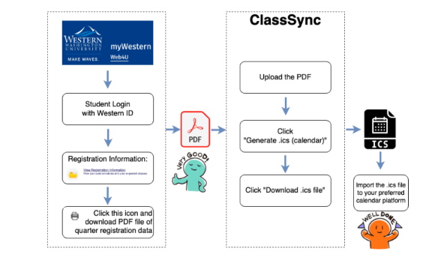
CLASSSYNC
Prototype: Early Decisions
Early decisions
The team explored multiple low-fidelity designs, then converged on one ordered flow.
Instructions moved onto the main page instead of a separate manual page.
The design favored a web app over a browser extension for easier mobile and desktop access.
05

Slide 6
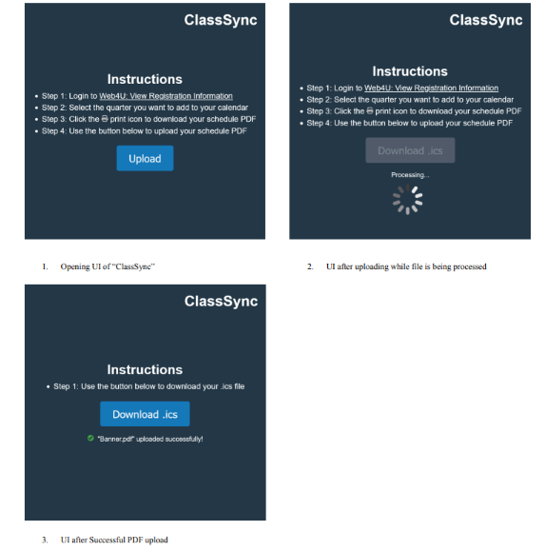
CLASSSYNC
Prototype Walkthrough
Core flow
Read instructions
Upload schedule PDF
Generate calendar data
Download .ics
Preview or import schedule
06

Slide 7
CLASSSYNC
Evaluation Plan and Metrics
Usability
SUS survey for the experimental group
Grade A expected if the first hypothesis holds
Prototype SUS test with three WWU users: 95, 100, 92.5
Effectiveness
Quarter-end schedule-management survey scored out of 40; compare class-level averages and grand averages between control and experimental groups.
10

Slide 8
CLASSSYNC
Final Design and Implementation
The repository's final software is a Chrome extension plus an instructional website.
1
Canvas token
2
Worker
3
Popup UI
4
.ics export
>
>
>
User saves a Canvas API token in local Chrome storage.
Service worker requests active courses and assignment calendar events from WWU Canvas.
Popup lists upcoming events and handles sync/download actions.
Events are converted into iCalendar text and downloaded as canvas_events.ics.
Implementation assets: Manifest V3 extension, popup.js, background.js, styling, icons, setup instructions, and demo video.
07

Slide 9
CLASSSYNC
Changes From Prototype to Final Software
Prototype direction
Final implementation
Single-page web app
Chrome extension
Upload Web4U schedule PDF
Key shift
Use Canvas API token
Parse class meetings
From file parsing toward API-based calendar sync
Fetch assignment calendar events
Download generated .ics
Show synced events in popup
Calendar preview planned
Download .ics from live Canvas data
08

Slide 10
CLASSSYNC
Experiment Design
Two hypotheses
Study structure
WWU students are satisfied with ClassSync's usability.
Longitudinal study across one academic year
ClassSync improves efficiency in schedule management.
Stratified random sampling by class level
250 full-time WWU students total
Between-subjects comparison: ClassSync vs. current tools
09

Slide 11

CLASSSYNC
Evaluation and Conclusion
Evaluation
Students want fewer disconnected schedule surfaces.
The prototype tested very well for perceived usability with all A-grade SUS results.
Experiment to be conducted, which will test long-term schedule-management impact
Future work should reconcile Web4U class schedules, Canvas assignment events, and Outlook/Google/iCalendar import into one stable flow.
Conclusion: ClassSync is most valuable when it turns scattered academic schedule data into a portable calendar students already trust.
11

